Slide 1
A Framework For Identifying Communities in Dynamic Social Networks (KDD2007)
Chayant Tantipathananandh,Tanya Berger-Wolf,David Kempe

Slide 2
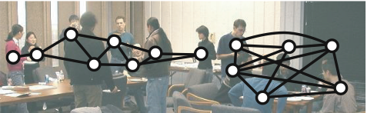
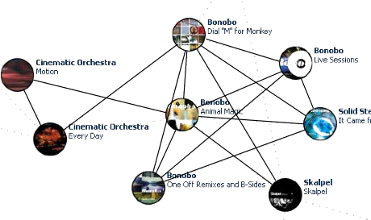
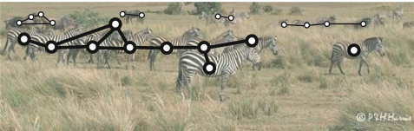
Social Networks
Notes:
WHAT IS SOCIAL NETWORK?
Social networks are a mathematical model of interactions.
CONTEXTS
Interactions can be physical proximity of people like KDD conference, e.g., we are being in the same room, terrorists attending the same flight school at the same time, zebras being spotted together, or items or music albums being bought together in the same cart.
REPRESENTATION
We usually represent a social network as a graph where nodes represent individuals and edges represent interactions between the corresponding individuals.
.

Slide 3

History of Interactions
Aggregated
network
1
2
1
3
2
3
2
5
1
1
1
t=1
4
2
3
History of interactions
5
4
2
3
1
t=1
5
4
5
2
3
4
1
t=2
5
2
4
1
t=3
5
2
3
4
t=4
Assume discrete time and interactions in form of complete subgraphs.
5
2
4
3
1
t=5
Notes:
One problem with using graph to represent a social network is that network is not static and can change over time. We lose some information by using a graph to represent a network, in particular when networks change over time.
One scenario is the following. We observe a social network in 5 time steps. Each time step we saw a snapshot of the network. E.g., in the first time step, we saw individuals 1-3 being together in a group while 4 and 5 were being isolated. After observing the network for a while, we have history of interactions in the network. Here, we consider the case when interactions are group-wise, that is all individuals in a group are considered interacting with each other. Formally, each snapshot is a collection of pairwise disjoint subsets of individuals.
Conference (KDD) example. Groups are sessions.
The aggregated network of this scenario is shown on the top where edge weights are the frequency of the interaction. In this simple example, if we shuffle the snapshot in the history of interactions, we still get a different scenario of interactions but the aggregated network is still the same.
This slide is still confusing to Mayank.
Stick to either aggregated network or static network.
NETWORK OVER TIME
When looking at a social network that changes over time, we see history of interactions.
AGGREGATED NETWORK
The way people usually do social network analysis is to aggregate information about interactions over time and represent it as an aggregated network whose edge weights encode frequency, intensity, etc. of interactions over time.
A SERIES OF INTERACTIONS
Another possible representation is to record interactions in the network over time. When assuming that time is discrete, we see a series of snapshots of the social network. In this work we also assume that interactions are in the form of complete subgraph, or we can derive such interactions form the snapshot of the network. Each snapshot is then a collection of pirwise disjoint subsets of individuals.
AGGREGATED NETWORK VS. A TIME SERIES
It is easy to see that there are several settings that have the same aggregated network, e.g., by shuffling the history of interactions, we obtain different settings that have the same aggregated network. When we ask a question about the network and trying to answer by looking at the aggregated network alone, we might obtain a wrong answer.
Tanya’s comment
don’t use the word wrong answer. Emphasize that communities change over time. E.g., some come to KDD every year, some came last year and stopped coming, some might come back later. Communities are living entities so we would like to see how they evolve over time.

Slide 4
Community Identification
What is community?
“Cohesive subgroups are subsets of actors among whom there are relatively strong, direct, intense, frequent, or positive ties.” [Wasserman & Faust ‘97]
Notions of communities:
Static
Centrality and betweenness [Girvan & Newman ‘01]
Correlation clustering [Basal et al. ‘02]
Overlapping cliques [Palla et al. ’05]
Dynamic
Metagroups [Berger-Wolf & Saia ’06]
Notes:
There are many important questions in social network analysis and one of them is how to identify communities. Wasserman & Faust characterize community as a subset of individuals who interact more frequently, strongly among each other than other individuals outside the community. People have proposed many notions of communities, e.g., the one based on betweenness centrality, correlation clustering, and overlapping clieques. There are still many others; however, most of them utilize aggregated network of some kind. Recently, there is a notion of community that is explicitly based on history of interaction: metagroups. However, infering concrete communities from metagroups is not an easy task and we can only compute statistics of metagroups. This work takes the idea behind the metagroups framework and focus on finding concrete communities.
==========
Don’t go into details of metagroups
Include a paper from PNAS about using compression to find communities.
One important question in social network analysis is how to identify communities in the network.
WHAT IS COMMUNITY?
Wasserman and Faust characterize community as a subset of individuals who interact with each other more frequently than other individuals outside the community.
PREVIOUS METHODS OF IDENTIFYING COMMUNITIES
There are many methods of identifying communities have been proposed, though most of them utilize aggregated model of network. For examples, a method that uses betweenness centrality, correlation clustering, and overlapping cliques. As I have mentioned that networks can change over time and aggregated model is not powerful enough to answer certain questions.
WHAT IF COMMUNITIES CHANGE OVER TIME AS WELL AS THE NETWORK?
How do we track their changes?
Not until recently that there is a notion of dynamic communities: metagroups. However, identifying all metagroups in a network is not an easy task and we can only compute statistics of metagroups, e.g., average time-span of metagroups. This work takes the idea behind the metagroup and try to identify concrete communities.

Slide 5
The Question: What is dynamic community?
t=1
5
4
2
3
1
t=2
5
2
3
4
1
t=3
5
2
4
1
t=4
5
2
3
4
t=5
5
2
4
3
1
A dynamic community is a subset of individuals that stick together over time.
NOTE: Communities ≠ Groups
Notes:
So what is dynamic community? It is a subset of individuals that tend to stick together over a period of time. Let me give an example of what a community that exists over time is like. Individuals 2 and 3 tend to be together at the beginning and their interactions fade away at the end. So the question is, by looking at history of interactions, how do we identify who were in the same community as whom at a certain time and how individuals move between communities.
COMMUNITIES != GROUPS
So there are three main objects: individuals, groups, and communities. Both groups and communities are subsets of individuals; however, groups are what we observe and exist within a snapshot, while communities are what we would like to infer and they can span over multiple snapshots and change over time. These are the concepts that are going to turn in to our formulation of community.

Slide 6
Approach: Graph Model
t=1
5
4
2
3
1
5
1
2
3
4
t=2
5
2
3
4
1
5
1
2
3
4
t=3
5
2
4
1
5
1
2
3
4
t=4
5
2
3
4
5
1
2
3
4
t=5
5
2
4
3
1
5
1
2
3
4
Notes:
HOW DO WE GO ABOUT FINDING COMMUNITIES?
First, we create a graph model from history of interactions. We create an individual vertex (circles) for each individual and each time step no matter if an individual was observed or unobserved at that time. Then we connect individual vertex at time t to vertex at time t+1 with an edge so that vertices of each individual form a time line.
Then we create a group vertex (squares) for every group that was observed. Then we connect each group to the its members with an edge.

Slide 7
Approach: Assumptions
Required
Individuals and groups represent exactly one community at a time.
Concurrent groups represent distinct communities.
Desired
Conservatism: community affiliation changes are rare.
Group Loyalty: individuals observed in a group belong to the same community.
Parsimony: few affiliations overall for each individual.
Notes:
To model communities, we made the following assumptions.
[Criticize yourself about these two assumptions.]
Two big assumptions that we made about communities are:
Both individuals and groups belong to exactly ONE community at a time. In real life, individuals and groups may have multiple roles and belong to more than one community at a time. Actually this assumption is the one that makes the problem hard. However, we stick with this assumption in this work and leave the relaxation for future work. Also, although individuals may belong to only one community at a time, an individual can belong to different communities over time. The fact that they are putting on one hat at a time, doesn’t disallow them to change their hat. As we will see.
Groups that were observed at the same time belong to different communities. Since they were observed to be separate, there must be a reason for that should belong to different communities.

Slide 8
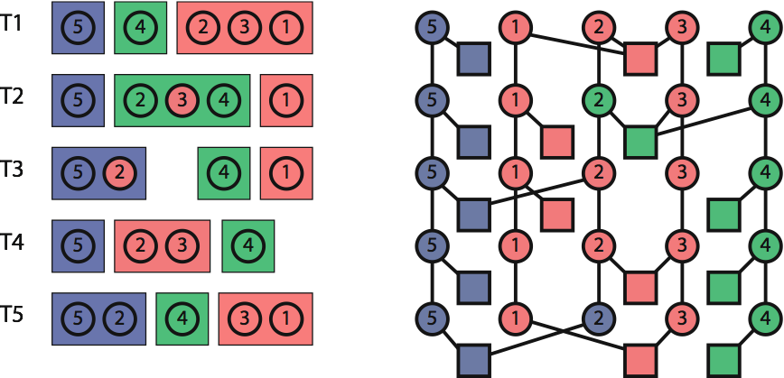
Approach: Color = Community
Valid coloring: distinct color of groups in each time step
Notes:
These two assumptions are translated into how we find communities using the graph model. We color each vertex with one color because of the first assumption and a coloring is valid if and only if vertices of groups that were observed at the same time have a distinct color.
COMMUNITY STRUCTURE & AFFILIATION SEQUENCES
Then for any valid coloring,
groups that have the same color represent the same community
When an individual have the same color as a group at a certain time, it is affiliated with the community the group represents.
Since there are many valid colorings for any graph, we need to characterize what is considered good community.

Slide 9
Approach: Assumptions
Required
Individuals and groups represent exactly one community at a time.
Concurrent groups represent distinct communities.
Desired
Conservatism: community affiliation changes are rare.
Group Loyalty: individuals observed in a group belong to the same community.
Parsimony: few affiliations overall for each individual.
Notes:
Here are three assumptions we made about how individuals choose their community.
Conservatism: when an individual is affiliated with one community, it tends not to change its affiliation to another community in the next time step.

Slide 10
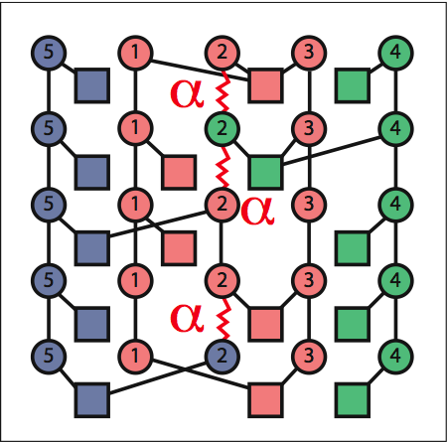
Costs
Conservatism: switching cost (α)
Group loyalty:
  Being absent (β1)
  Being different (β2)
Parsimony: number of colors (γ)
Notes:
Conservatism is translated into alpha cost. For each edge that connects two individual vertices, if its end points have a different color, then there is a cost of alpha added to the total cost.

Slide 11
Approach: Assumptions
Required
Individuals and groups represent exactly one community at a time.
Concurrent groups represent distinct communities.
Desired
Conservatism: community affiliation changes are rare.
Group Loyalty: individuals observed in a group belong to the same community.
Parsimony: few affiliations overall for each individual.
Notes:
2)Group loyalty: when individuals were observed together in a group, they were affiliated with the same community.

Slide 12
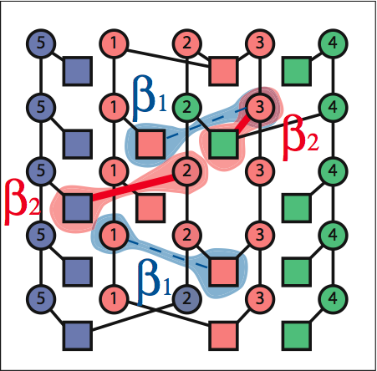
Costs
Conservatism: switching cost (α)
Group loyalty:
  Being absent (β1)
  Being different (β2)
Parsimony: number of colors (γ)
Notes:
This is translated into two costs: cost of being absent (beta1) and cost of being different (beta2).
When an individual vertex has the same color as some group in the same time step but they are not connected by an edge, there is a cost of being absent, beta1, added to the total cost.
When an individual vertex is connected to a group that has a different color, there is a cost of being different, beta2, added to the total cost.

Slide 13
Approach: Assumptions
Required
Individuals and groups represent exactly one community at a time.
Concurrent groups represent distinct communities.
Desired
Conservatism: community affiliation changes are rare.
Group Loyalty: individuals observed in a group belong o the same community.
Parsimony: few affiliations overall for each individual.
Notes:
3)Parsimony: we would like each individual to be affiliated with as few communities as possible over all.

Slide 14
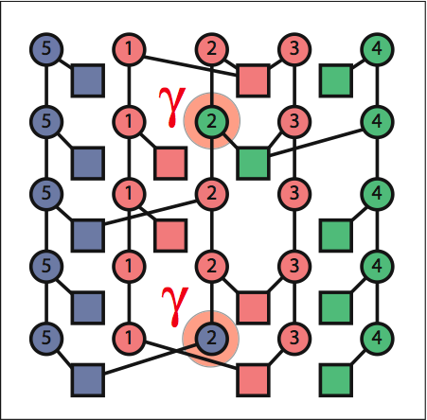
Costs
Conservatism: switching cost (α)
Group loyalty:
  Being absent (β1)
  Being different (β2)
Parsimony: number of colors (γ)
Notes:
For each color that each individual has extending its first one, there is a cost of gamma added to the total cost.

Slide 15
Problem Definition
Minimum Community Interpretation
For a given cost setting, (α,β1,β2,γ), find vertex coloring that minimizes total cost.
  Color of group vertices = Community structure
  Color of individual vertices = Affiliation sequences
Problem is NP-Complete and APX-Hard
Notes:
Having formulated the assumptions, we can now define the problem of identifying communities.
We call it MINIMUM-COMMUNITY-INTERPRETATION problem. For a given cost setting (alpha, beta1, beta2, gamma) and a series of interactions, find a vertex coloring of the graph model that minimizes the total cost incurred.
An optimal coloring = minimum community interpretation = most explanation of communities in network
Color of group vertices INTERPRETS the community structure: how communities exist in the network.
Color of individual vertices INTERPRETS affiliation sequences of individuals: who belong to which community at a certain time.
We have proved that the decision version of this problem is NP-Complete and APX-Hard (inapproximable within a constant). The proofs can be found in the paper.

Slide 16
Model Validation and Algorithms
Model validation: exhaustive search for an exact minimum-cost coloring.
Heuristic algorithms evaluation: compare heuristic results to OPT.
Validation on data sets with known communities from simulation and social research
    Southern Women data set (benchmark)
Notes:
We also validated our model of community by conducting experiments on networks that we know what are communities.
We developed exhaustive search for finding exact optimal colorings and fast heuristics that find near optimal solutions.
To validate our model, we ran exhaustive search on two kinds of data sets: data sets that we embedded communities in and a data set from social science research.
The one I’m going to show next is from social science research: Southern Women data.

Slide 17
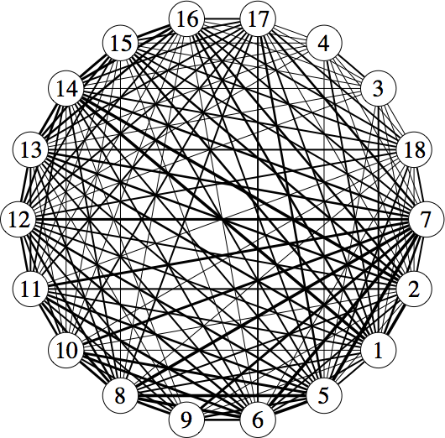
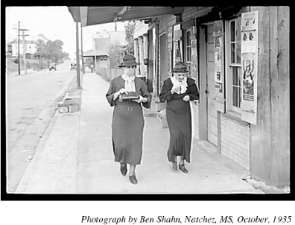
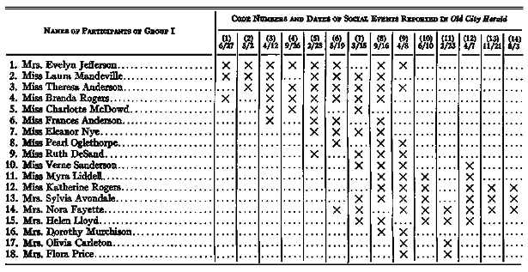
Southern Women Data Set by Davis, Gardner, and Gardner, 1941
Photograph by Ben Shaln, Natchez, MS, October; 1935
Aggregated network
Event participation
Notes:
Southern Woman data is published in the book by DaviS, Gardner, and Gardner, 1941. They studied social event participation of 18 women in Natchez, MS, over a period of 14 social events. The rows in the table blow are the women and each column is one social event. The x-marks indelicate who participated in what event.
The aggregated network suggests that every individual is connected to pretty much every one else. It is hard to see that there can be more than one community.

Slide 18
Ethnography
by Davis, Gardner, and Gardner, 1941
Core (1-4)
Periphery (5-7)
Periphery (11-12)
Core (13-15)
Notes:
The ethnography published in the same book by DGG1941 tells us that there are two main communities in this network: green and yellow.
The core members of the two communities are 1-4 and 13-15.

Slide 19
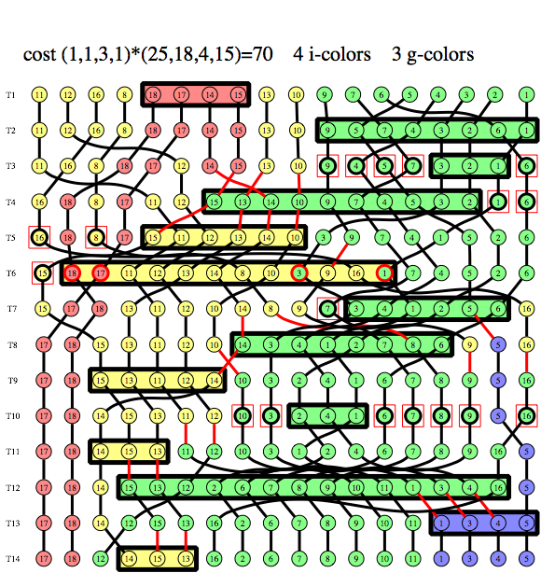
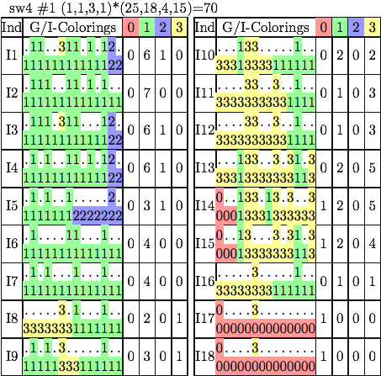
An Optimal Coloring: (α,β1,β2,γ)=(1,1,3,1)
Core
Periphery
Core
Periphery
Notes:
Here is a result of our method. When we emphasize GROUP LOYALTY in the cost setting, an optimal coloring shows that there are two main communities in the network and their core members are 1-4 and 13-15 as identified by ethnography by DGG41.
Moreover, our result give an explanation of changes in the network. By looking at the series of interactions color-coded in the left picture, we can see who were in the same community as whom at a certain time.

Slide 20
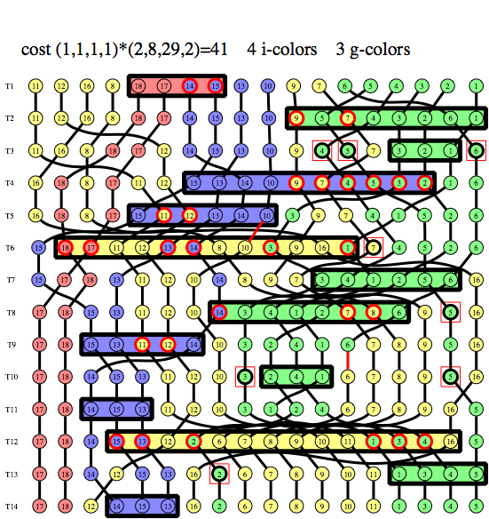
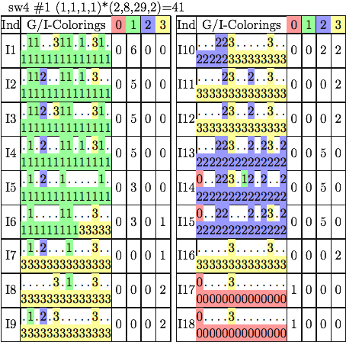
An Optimal Coloring: (α,β1,β2,γ)=(1,1,1,1)
Core
Core
Periphery
Notes:
When we emphasize conservatism in the cost setting, an optimal coloring vies an alternative view of communities in this network.
There are three main communities in this result. Green community is still green from the previous slide, but blue community here is the yellow from the previous slide. The new community is the yellow one.
The history of interactions in the left picture shows that the yellow groups are the two biggest meetings in the network. This new community is the set of individuals who were unobserved for the most of the time. They are the ones who did not belong to either green or blue communities. And that is another interpretation of communities in this network.

Slide 21
Conclusions
An optimization-based framework for finding communities in dynamic social networks.
Finding an optimal solution is NP-Complete and APX-Hard.
Model evaluation by exhaustive search.
Heuristic algorithms for larger data sets. Heuristic results comparable to optimal.
Notes:
To wrap thing up,
We proposed a framework for finding communities in dynamic social networks.
We proved in the paper that the problem is NP-Complete and APX-Hard
We evaluated our model by running exhaustive search and comparing an optimal solution to the true known communities.
We developed several fast heuristics. And I’m just going to say that the heuristics results are comparable to OPT.

Slide 22
Thank You
Poster #6 this evening
Notes:
Thank you.
Poster #6 tonight

Slide 23
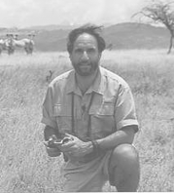

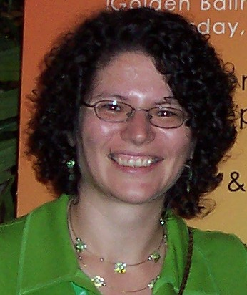
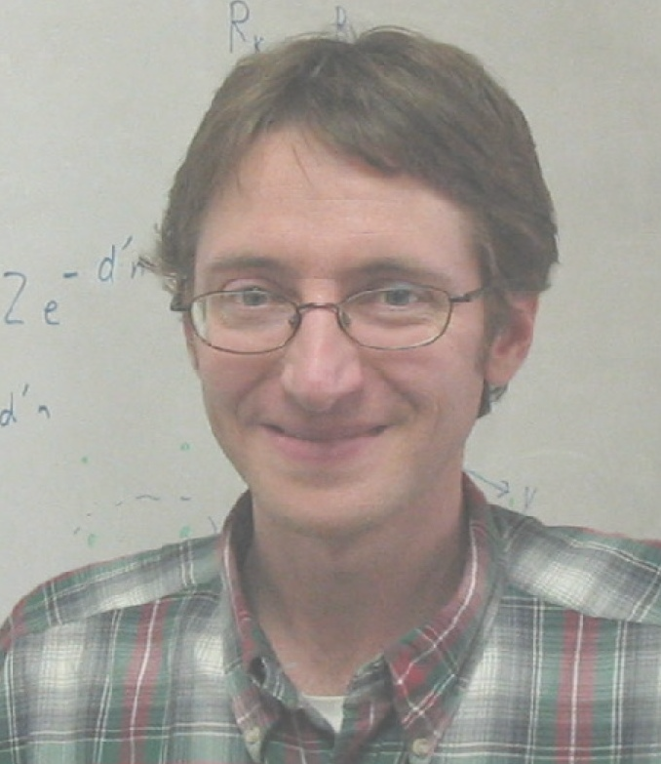
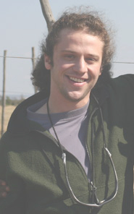

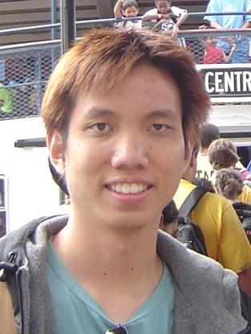

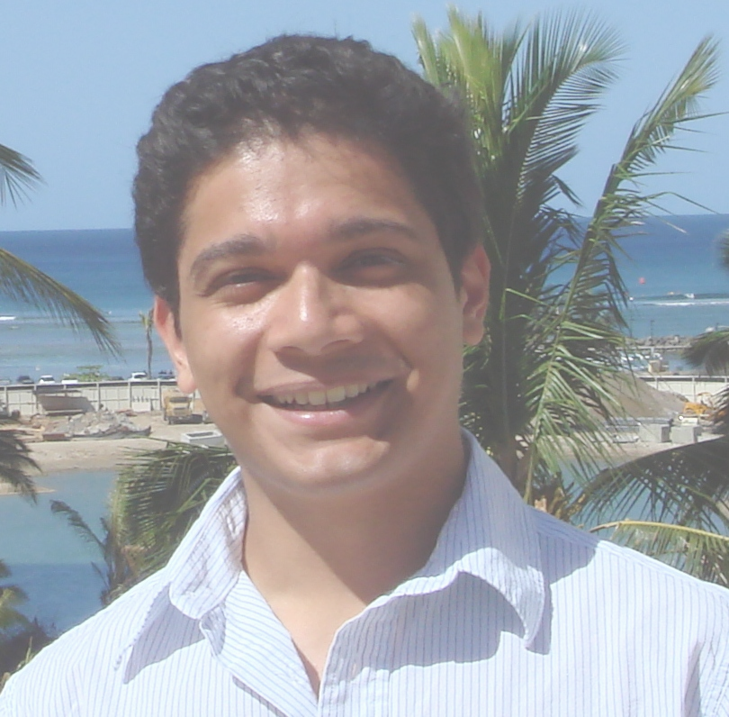
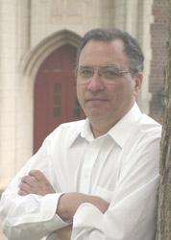





Computational Population
Biology Lab
UIC
compbio.cs.uic.edu
David Kempe
USC
Dan Rubenstein
Princeton
Tanya
Berger-Wolf
Poster#6
this evening
Jared Saia
UNM
Ilya Fischoff
Siva
Sundaresan
Simon Levin
Princeton
Chayant
Tantipathananandh
Mayank Lahiri
Muthu
Google
Habiba
Notes:
This project is a part of a bigger project in our lab, computational population biology lab, UIC.
Mention about biologists studying zebras on the left hand side
People in the lab in the middle
Other corroborators in the right hand side.
Stop and ask “did I lose everybody?”
Confidence in your voice is more important than the clarity of what you are explaining.

